Slide 1
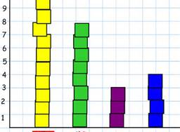
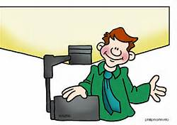
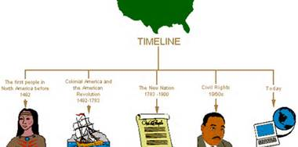
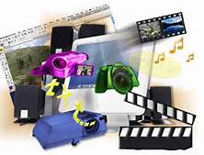
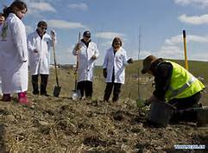
Hands-On Manipulatives
Modeling
Realia
Comprehensible
Input
Techniques
Maps
Pictures
Using Overhead Projector
Graphs
Timelines
Multimedia
Demonstration

